Slide 1



CSA1521 - CLOUD COMPUTING
CO1 - AT3 - TECHNICAL PRESENTATION
Presented By:
V.C.Bhavan Bairav (192511369)

Slide 2
ROLE OF DATA CENTERS IN CLOUD COMPUTING
Introduction
Cloud computing has transformed the way individuals and organizations store, process, and access data. Instead of relying on personal computers or local servers, cloud services are delivered through powerful data centers that operate continuously over the Internet. These data centers form the backbone of cloud computing by providing reliable, secure, and scalable computing resources to millions of users worldwide.
Objectives
Understand the concept of a data center.
Learn the role of data centers in supporting cloud computing.
Explore the basic architecture of a cloud data center.
Understand its industry relevance through a real-world example.

Slide 3
WHAT IS A DATA CENTER?
Definition:
A Data Center is a facility that contains servers, storage devices, networking equipment, and cooling systems to store, process, and manage data. It is the backbone of cloud computing because cloud services run from data centers.
Components:
Servers
Storage Systems
Networking Devices
Power Supply
Cooling Systems
Security Systems
Functions:
Stores user data
Runs cloud applications
Provides 24/7 availability
Ensures backup and disaster recovery

Slide 4
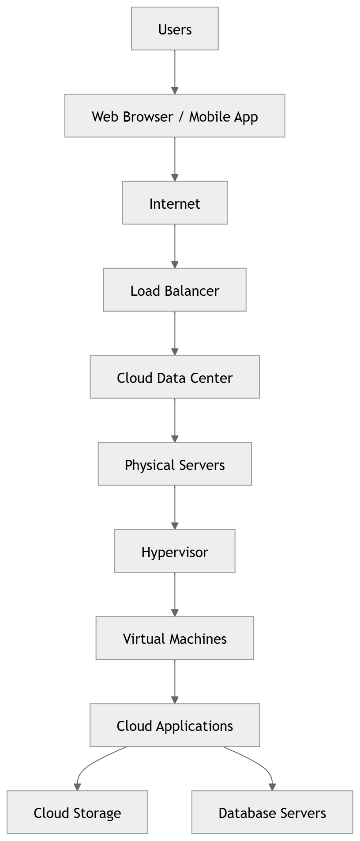
ARCHITECTURE OF A CLOUD DATA CENTER
Working
User sends a request.
Request reaches the cloud through the Internet.
Load balancer distributes the request.
Virtual machines process the request.
Data is stored in storage systems.
Results are sent back to the user.

Slide 5
INDUSTRY RELEVANCE & PRACTICAL EXAMPLE
Why are Data Centers Important?
Enable cloud computing services.
Provide high availability (24/7 service).
Support millions of users.
Offer scalability.
Improve security and reliability.
Real-World Example
Amazon Web Services (AWS)
AWS has data centers worldwide.
Hosts services like Amazon EC2 and Amazon S3.
Businesses rent computing resources instead of buying servers.
Other Examples
Google Cloud
Microsoft Azure

Slide 6
CONCLUSION
Data centers store and process cloud data.
They ensure high availability and security.
Virtualization improves resource utilization.
Cloud services depend on data centers.

